Slide 1
Module Assembly using a Gantry Positioning System
Kirk Arndt, University of Oxford
for the
Oxford Particle Physics Microstructure Detector (OPMD) group
D. Bortoletto, I. Shipsey, R. Plackett

Slide 2
Outline
Background
CMS Phase 1 Forward Pixel Upgrade
Module assembly sequence
Module assembly trials
Summary

Slide 3
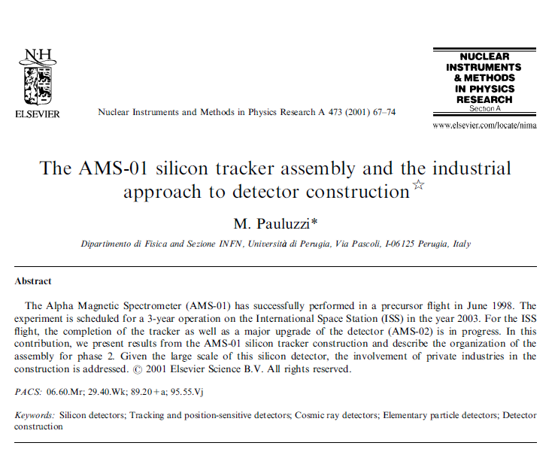
AMS silicon tracker construction
“Because of complexity, the largest fraction of defective ladders were due to operator mistakes or mishandling.
This particular failure demonstrates the need of developing, whenever possible, automated and operator-safe industrial procedures, not relying too much on operator (exceptional) expertise.
To this purpose, standard though very precise and reliable equipment has been (will be) used for the construction of the AMS-01 (AMS-02) silicon tracker.”
Notes:
“The construction of the AMS-01 silicon tracker took 8 months and 2 assembly lines, AMS-02 tracker construction is expected to take up to 16 months involving 3 assembly lines (not including spare ladders and contingency). All of this brings to an impressive assembly effort, a big step towards the LHC silicon detectors. We are, therefore, facing production on an industrial scale.”

Slide 4

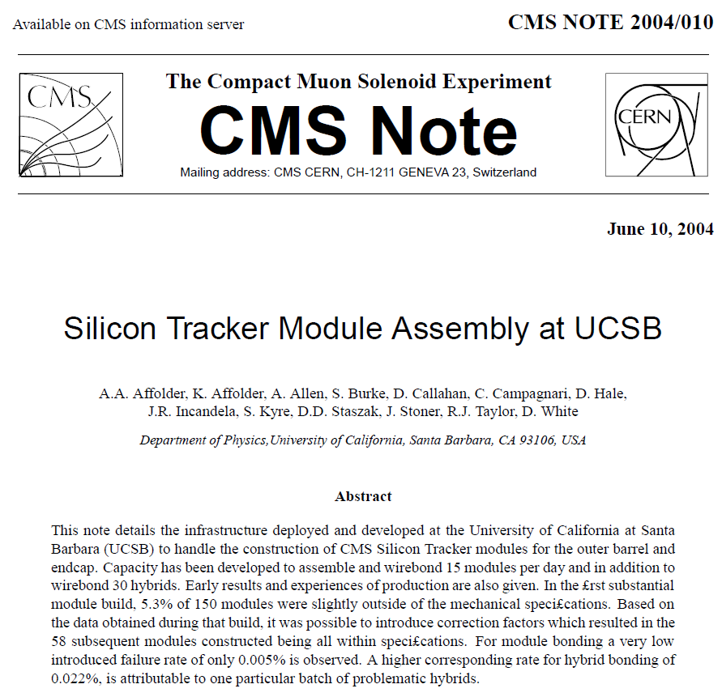
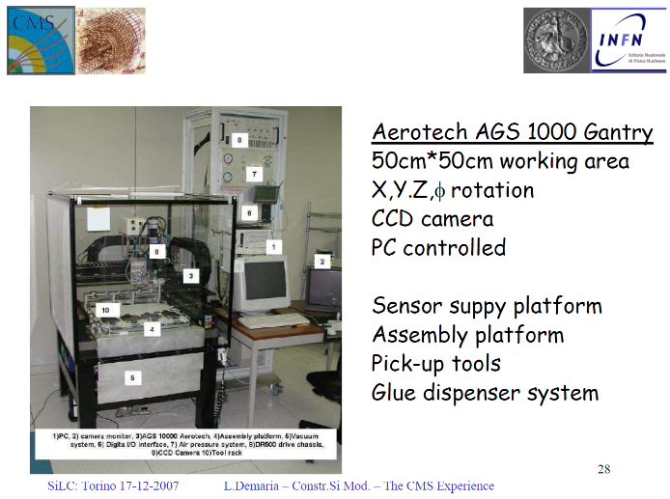
CMS strip tracker module assembly
Beginning over ten years ago, several institutions used gantry systems for assembly of modules for the current CMS strip tracker.
The group at the University of California at Santa Barbara developed a capacity to assemble (and wirebond) 15 modules per day (in addition to wirebonding 30 hybrids per day) for construction of the outer barrel and endcap.

Slide 5
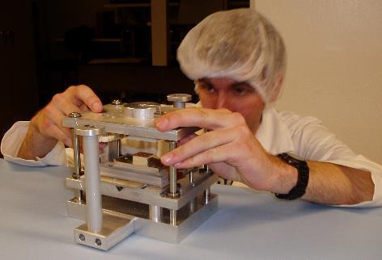
CMS FPix module assembly @ Purdue
In the same time period, the Purdue University group of Shipsey and Bortoletto developed manually-manipulated tools & techniques for assembly of ~1000 Pixel modules for the CMS pixel endcaps at a planned assembly rate of 6 modules per day.
We rarely used this capacity due to sporadic delivery of pixel module components. As a consequence, we suffered a 'standing army' problem of technicians trained to perform the technique-dependant manual assembly with not enough work to do.

Slide 6
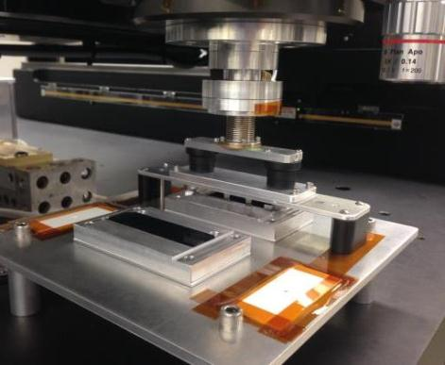
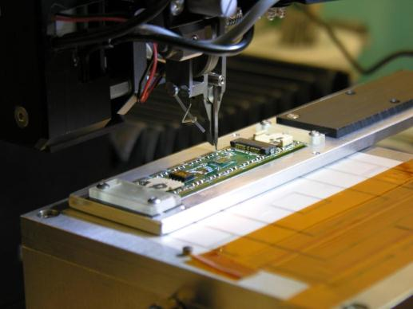
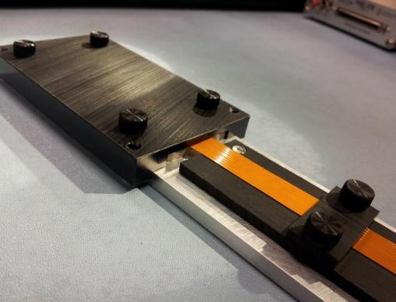
CMS Phase 1 Upgrade pixel modules
LHC CMS
Detector
Upgrade
Project
Based on this experience and demonstrations of the benefits of an increase in automation of assembly, the Purdue group purchased an Aerotech 4-axis gantry system in 2010 and began to prepare it for the assembly of modules for the CMS Phase 1 Upgrade pixel detector
University of Nebraska-Lincoln followed in 2012, adopting the Purdue pioneered design and assembly procedure
Videos from the development of pixel module assembly on the Aerotech gantry system at Purdue are posted at https://www.youtube.com/watch?v=X_o66K6k1bk&index=4&list=PLA15CB279F6A0E05A and https://www.youtube.com/watch?v=ojeVwQxOrGo&feature=youtu.be

Slide 7
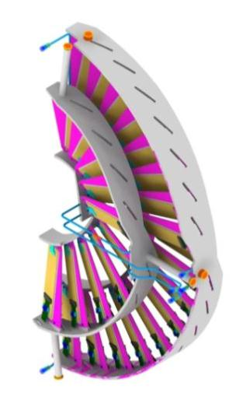
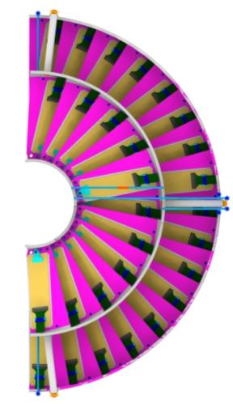
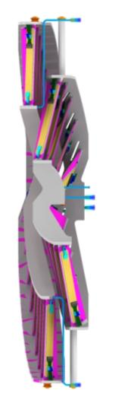
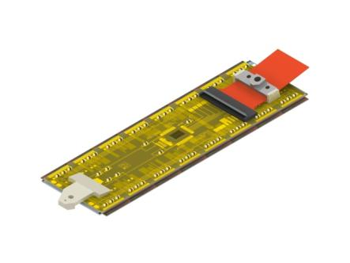
Forward Pixel Phase 1 Upgrade
LHC CMS
Detector
Upgrade
Project
Pixel module
outer
ring
Flex cable
inner
ring
HDI flex with connector and TBM on top
of BBM
2x8 Bump-Bond Module
present detector
upgrade detector
2 disks on each side of the IP
One ring per half disk
672 modules with 18M pixels
5 different module sizes for FPIX
3 disks on each side of the IP
Two concentric rings (inner and outer) for easy replacement
672 modules with ~45M pixels
Same size module as barrel (2x8 ROCs)
Notes:
FPix Phase 1 Upgrade Main Features
Technical Proposal Baseline: 3 disks in each endcap
Use only ONE kind of module (2x8)
All modules arranged radially and placed between r=45mm to 161mm (total 56 modules per half disk or 896 ROCs)
Modules in half-disks divided into an outer ring of 34 modules and inner ring of 22 modules (with the inner assembly easily removed without affecting the outer assembly)
Same 20 degree rotation of sensors as current FPIX, but add a 12 degree tilt w.r.t. the IP for the inner modules (inverted cone geometry)
Use C02 cooling
Thin‐walled SS tubing routed in loops through ring structures providing enough cooling power for each blade assembly
Use ultra light weight materials for mechanical support and cooling (estimated weight of each half disk is ~400g)
Substrates are permanently glued to half rings in a “turbine‐like” structural support, including cooling tube routed in rings. Allows us to complete and thoroughly test all half disk structures without waiting for the availability of the pixel modules
Modules are fastened on blades and can be easily removed.

Slide 8
FPIX Module Assembly and Testing
LHC CMS
Detector
Upgrade
Project
Pre-production and production assembly, testing and delivery of all pixel modules required for the Phase 1 FPIX Upgrade, including pre-production modules for a pilot system.
Two module assembly and testing sites: Purdue University and University of Nebraska
Purdue was the previous FPIX module production center
UNL led module testing at Fermilab and has a strong connection with PSI
Both groups have a long history in silicon trackers
Testing includes module tests with x-rays at KU and UIC
For production, a total of 1000 modules is expected to be produced
800 production, 200 spares
Require 672 high-quality 2x8 ROC pixel modules
Yield of production required: ~85% (from sensor to final assembly on half-disk)
Schedule: 14 months timeframe
Nominal rate: 3 modules/day at each of the two sites (PU and UNL)

Slide 9
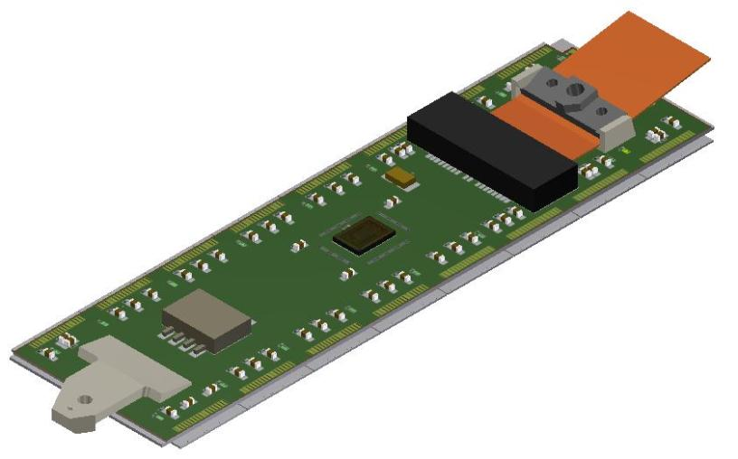
Phase 1 FPIX module
LHC CMS
Detector
Upgrade
Project
A 2x8 bump-bonded module (BBM) consists of a silicon pixel sensor bump-bonded to 16 ROCs (ReadOut Chips).
The High Density Interconnect (HDI) is attached to the BBM by an adhesive interface and wirebonds.
Cross-section of a pixel module
Flex cable strain relief
(built into module end holder)
Flexible Printed Circuit SMT connector
miniature DIP switch (optional – replaced by wirebonds for production)
HDI
Flat flex cable
75cm length
(short “connector saver” pigtail flex will be used for testing during assembly)
Module end holder
(with thru hole for #00 or M1.2 screw)
TBM
2x8 ROCs
FPIX sensor
Notes:
The DIP switch allows the address of the TBM to be easily set at the time of installation AND provides a convenient means of testing the ability of the TBM to respond to all possible address bit combinations (not so easily done with a wire bond pad array). This solution carries a cost; the DIP switch, while small, has mass. The switch body is plastic, while the contacts are copper or brass with gold plating. The estimate of effective % radiation length for the on-module flex cable connector is 0.02% (out of a total of 0.68% for the assembled module)...the DIP switch adds another ~0.02 %RL.

Slide 10
Steps to assemble a module
LHC CMS
Detector
Upgrade
Project
Bare module
Made of tested sensor and ROC’s
Shipped to sites from bump-bond vendor (RTI)
Visual inspection and sensor IV test
HDI
Fully assembled and tested at Fermilab
Shipped to UNL and Purdue from Fermilab
Visual inspection, pull test of wires bonded to test pads
Receive HDI
Glue HDI
to bare module
Wire-bonding
Potting
Testing
Shipping
Receive bare module

Slide 11
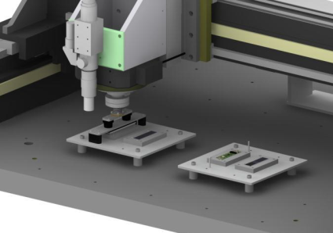
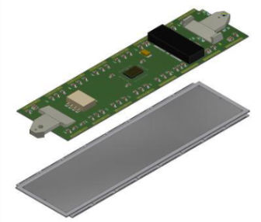
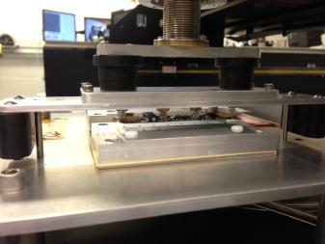
Steps to assemble a module
LHC CMS
Detector
Upgrade
Project
Semi-automated process
Robotic gantry positioning system
Applies epoxy to bare module sensor and places HDI
Alignment deviation <25 µm
Epoxy cures at RT in several hours
Time schedule
3 fixtures in gantry, expandable to 6
Works sequentially, fixtures stay in place
Labor: 2-3 hours per batch, including prep and clean-up
Receive HDI
Glue HDI
to bare module
Wire-bonding
Potting
Testing
Shipping
Receive bare module

Slide 12
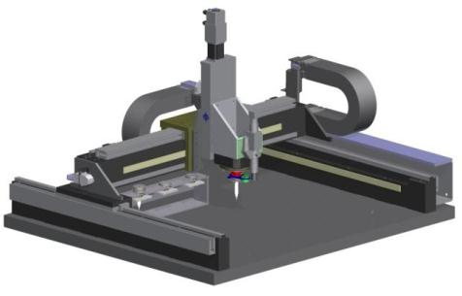
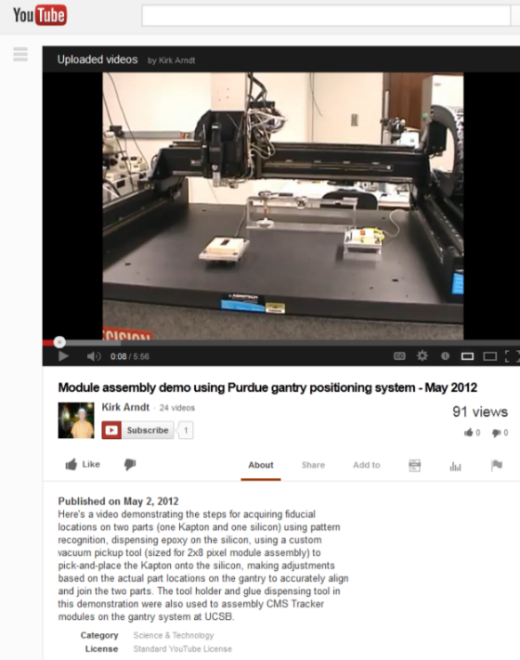
Semi-automated module assembly station
LHC CMS
Detector
Upgrade
Project
Robotic ‘pick-and-place’ machine for systematic module assembly, consists of:
Aerotech AGS10750 Gantry positioning system (750mm x 750mm x 100mm travel)
integrated with vision, pattern recognition, electro-valves and sensors, and custom vacuum + air pressure tools, liquid adhesive dispenser, LabVIEW programs
Notes:
We will use a robotic ‘pick-and-place’ machine, shortening the process time, improving the uniformity of production, and reducing the risk of a
‘standing army’ if there are delays in the supply of components.
Aerotech AGS15000 Linear Motor Gantry Positioning System and ADRS-150 Rotary Stage
EFD Ultimus V liquid dispensing controller
LabVIEW programmable
Reliable and repeatable semi-automatic assembly
Extensive use of student labor for:
Development of tooling and procedures
prototype module assembly.
Videos demonstrating the progress made with the steps for acquiring the fiducial locations on two parts (one Kapton “HDI” and one silicon “sensor”) using pattern recognition, dispensing epoxy on the sensor, and use of a custom vacuum pickup tool (of the scale appropriate for 2x8 pixel module assembly) to pick-and-place the Kapton onto the sensor, making adjustments based on the actual part locations in the gantry to accurately align and join the two parts.

Slide 13
Process flow for assembly of 2x8 BBM and HDI using semi-automated assembly machine
LHC CMS
Detector
Upgrade
Project
Auto
Manual
Pattern recognition finds fiducial centroids
Place HDIs on vacuum chucks
Turn on vacuum to the chucks
Move camera to ideal locations of fiducials
Start
Place 2x8 BBMs on vacuum chucks
Dip stamp in glue/apply glue to sensors on 2x8 BBMs
Return glue dispensing stamp to tool rack
Pickup glue dispensing stamp from tool rack
Operator confirms acquisition of fiducials
Apply baseplate vacuum/Release bridge tools/HDIs held by tools while glue cures
Pick-and-Place HDI onto 2x8 BBMs using bridge tools
Pickup the vacuum spreader tool
Go to start
Notes:
Assembly sequence under development for assembly of Upgrade 2x8 BBM and HDI .

Slide 14
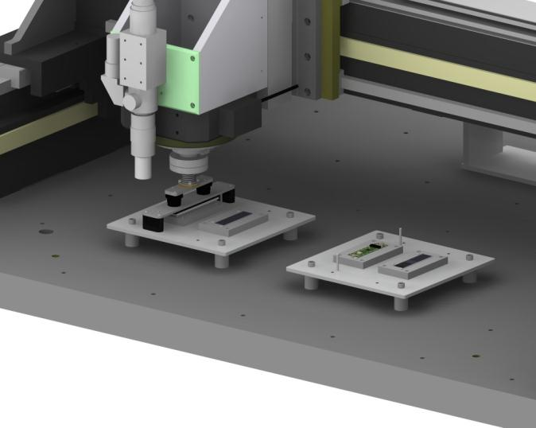
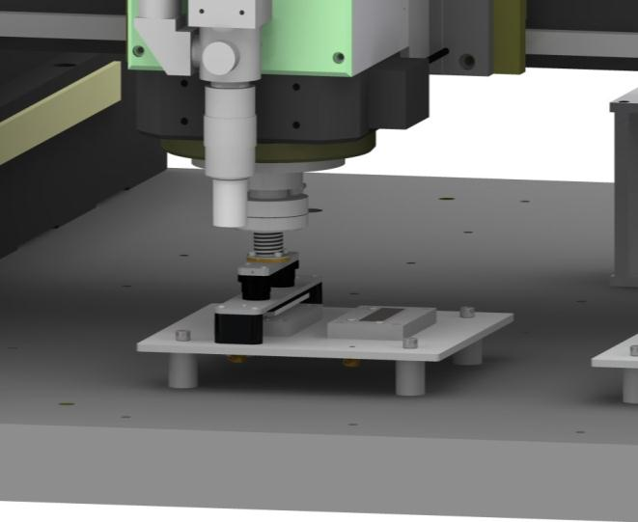
Semi-automated module assembly
LHC CMS
Detector
Upgrade
Project
Designed custom front-end tools to pick-and-place the HDI onto bare 2x8 bump-bonded modules
Fabrication of prototype tools is complete
Trials of module assembly are in progress

Slide 15
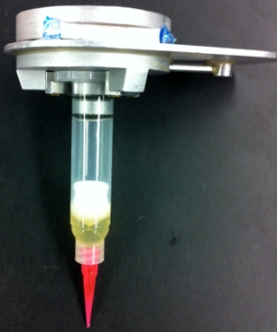
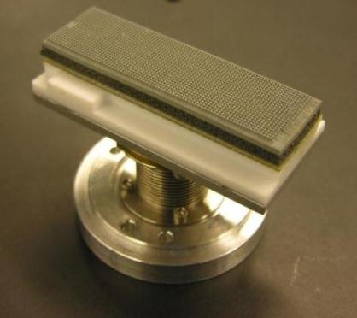
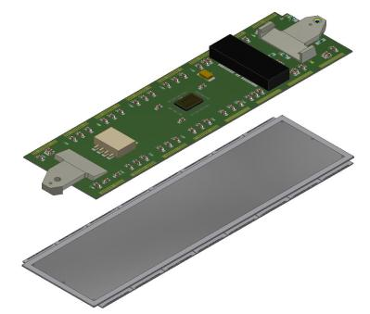
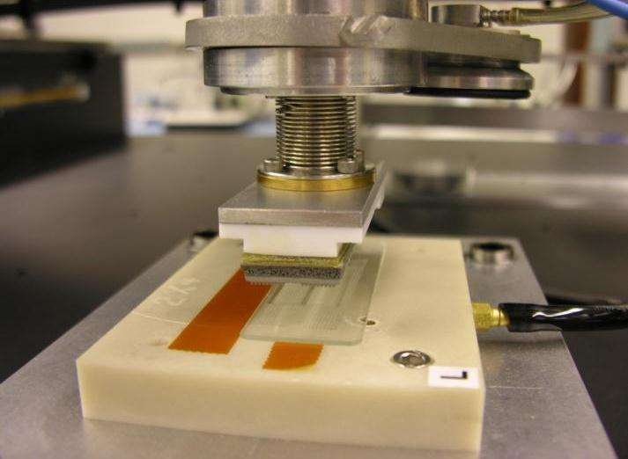
Semi-automated module assembly
LHC CMS
Detector
Upgrade
Project
HDI assembly
2x8 Bump-Bond Module
Initial epoxy dispensing trials used a syringe in a tool on the ‘pick-and-place’ machine
Now using a stamping tool to improve the uniformity of Araldite 2011 epoxy dispensing (similar to the process used by CMS Barrel Pixel groups)

Slide 16
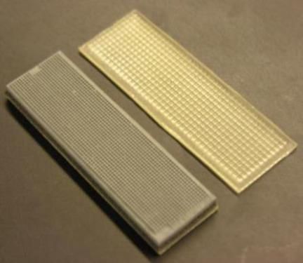
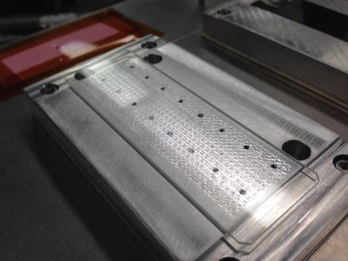
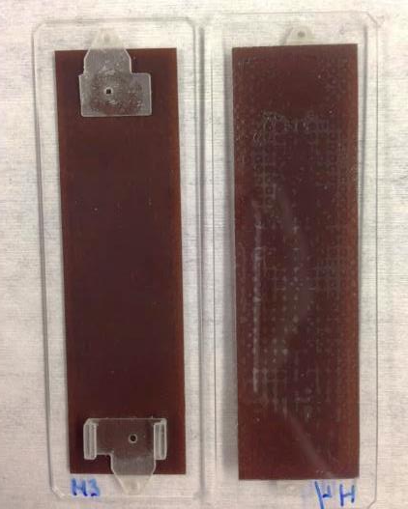

Module assembly trials
LHC CMS
Detector
Upgrade
Project
Evaluated different rubber stamps for depositing epoxy onto the sensor for gluing HDIs to 2x8 bare modules.
Designed a custom front-end tool for stamping the epoxy using the gantry positioning system.
Bonded numerous mock-up HDI onto glass slides to inspect epoxy bond coverage.

Slide 17
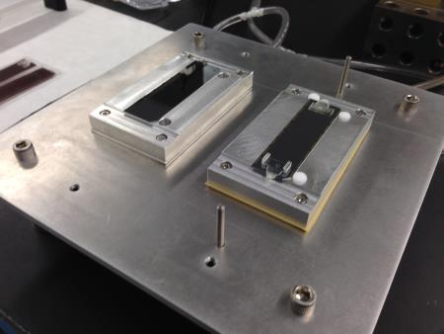
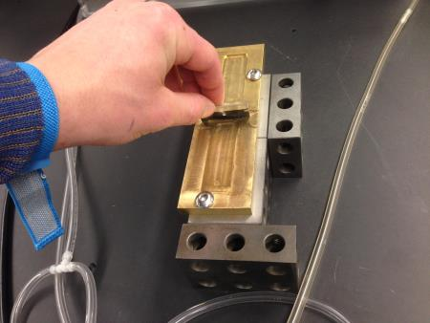
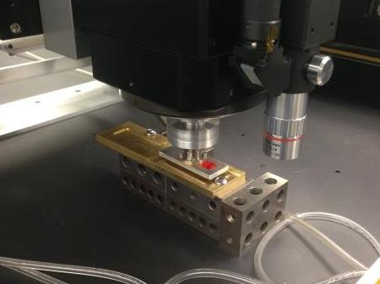
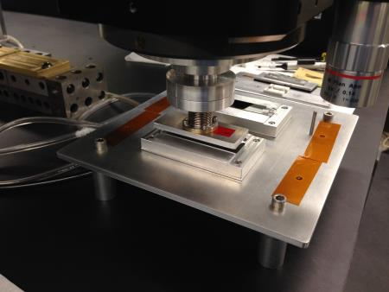
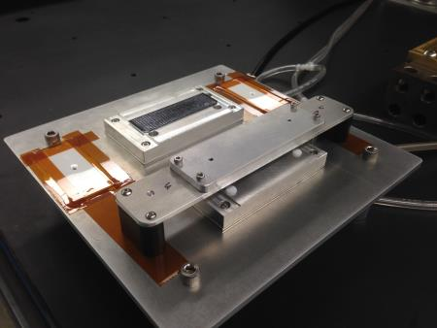
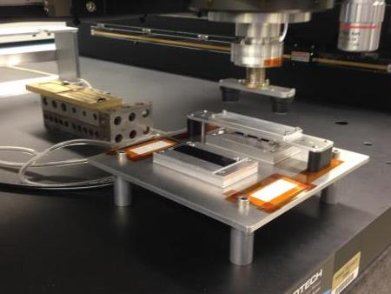
Module assembly trials
LHC CMS
Detector
Upgrade
Project
Epoxy stamping and pick-and-place assembly of mechanical grade components using the gantry and custom front-end tools

Slide 18
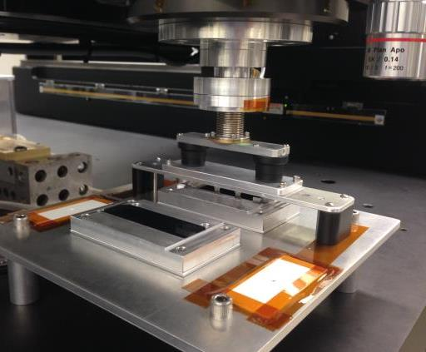
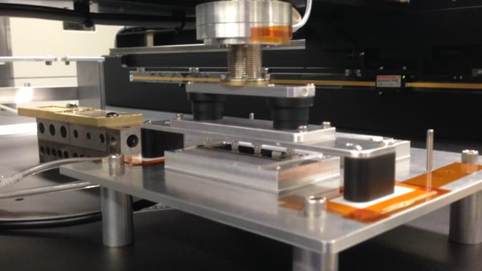
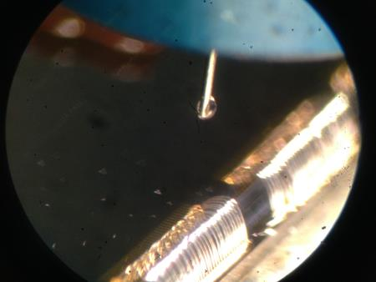
Module assembly trials
LHC CMS
Detector
Upgrade
Project
Dozens of mock-up modules assembled with mechanical grade components to inspect HDI placement accuracy, wire bond and encapsulation programs

Slide 19
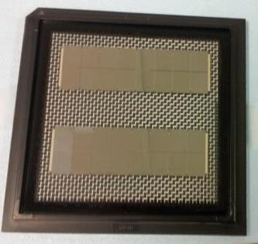
Summary - FPix Upgrade module assembly
LHC CMS
Detector
Upgrade
Project
Robustness
One module type simplifies design and fabrication
Significantly reduces the risk associated with sensor, bump bonding, and module assembly yield compared to a design requiring many sensor types
Uniformity among module assembly/testing sites
Both sites are replicas using same setup and tools
Established exchange of drawings, code, experience, etc.
pre-production BBMs delivered to Purdue and UNL
Yield
85% expected (same type of hybrid, evolutionary approach, experienced people involved)
Delay of supplies (HDI, bare modules) or problems at one site
Either or both sites can be extended to higher throughput. 2x increase can be easily achieved with minimal effort by duplicating tools
Ready to begin pre-production module assembly and testing
Receive HDI
Glue HDI
to bare module
Wire-bonding
Potting
Testing
Shipping
Receive bare module

Slide 20

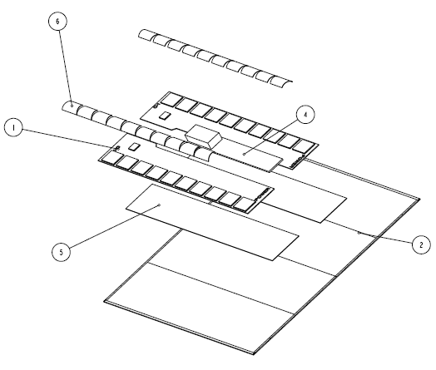
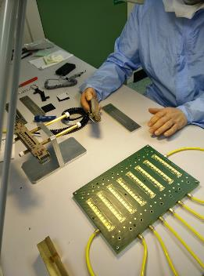
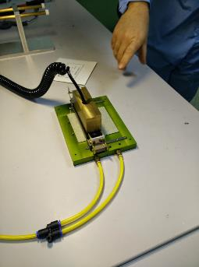
ATLAS Upgrade hybrid and module assembly
Tooling and procedures for gantry system similar to manual assembly:
ASICs picked up from the tray/chip carrier using a vacuum pickup tool, aligned/placed on vacuum chuck
Liquid adhesive dispensed onto hybrid using syringe (could be done off-gantry with a liquid dispensing robot)
10 aligned ASICs ‘pick-and-placed’ onto hybrid at the same time using a ‘bridge’ tool
Liquid adhesive dispensed onto sensor using syringe (could be done off-gantry with a liquid dispensing robot)
Pick up the completed hybrid via the chip faces, aligned/placed onto sensor using a ’bridge’ tool

Slide 21
Conclusion
Robotic assembly promotes a shorter production time, reduces a ‘standing army’ problem when unforeseen delays arise, and leads to uniformity of production assembly technique.
We plan to use a gantry system for ATLAS Upgrade strip (and pixel) module assembly at Oxford. So far, we haven't seen any module assembly steps that cannot be done on a gantry, and the merits of doing so certainly include some of the benefits mentioned above.
Semi-automated module assembly system could also be used for module placement on detector support structures. The inherent alignment accuracy of the gantry system is better than +/- 5 microns, with +/- 2 microns position repeatability.

Slide 22
Backup slides

Slide 23
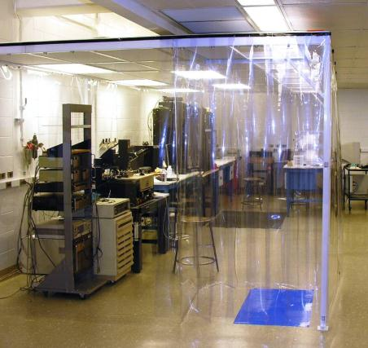
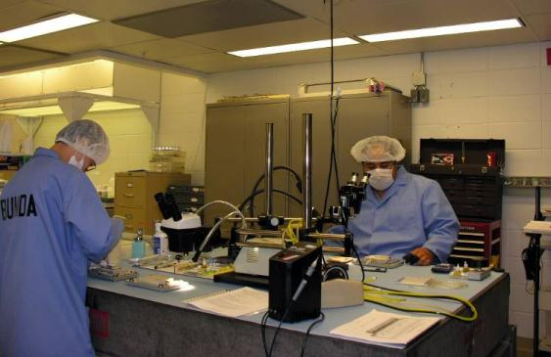
Module assembly and test facilities
LHC CMS
Detector
Upgrade
Project
Module assembly and testing takes place within Class 10K clean rooms
temperature and humidity controlled air
ESD protection at all work stations and floors
Five work stations at Purdue and Nebraska:
Station 1: Alignment, placement, and adhesion of HDI to sensor/ROC modules
Station 2: Wirebonding of ROCs and sensor bias to HDI
Station 3: Encapsulation of wirebonds
Station 4: Electrical functionality tests
Station 5: Inspection and rework of problems identified during tests.

Slide 24
Module assembly sequence
LHC CMS
Detector
Upgrade
Project
Untested bare 2x8 module
Fully assembled & tested HDI
Sensor IV test
Pick-and-place HDI to bare module
2-3 hrs, 1 person
Setup, inspection, clean-up and record-keeping at each step
Wirebond
0.5 hrs. per module, 1 person
Encapsulate
2-3 hrs, 1 person
Total time for assembling 1-6 modules = ~7 hrs by 3 persons
rework
Testing
Shipping

Slide 25
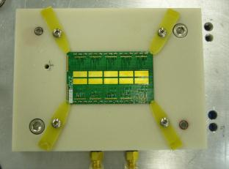
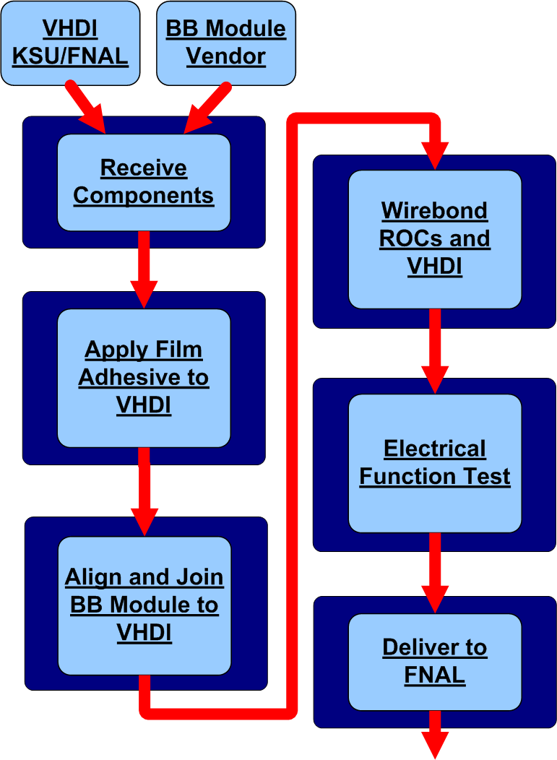
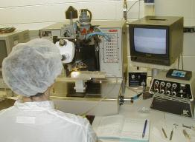
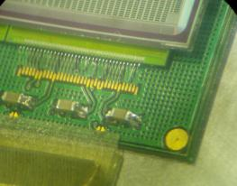
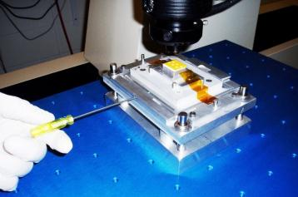
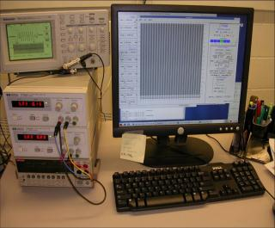
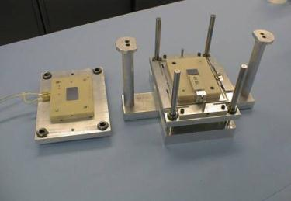
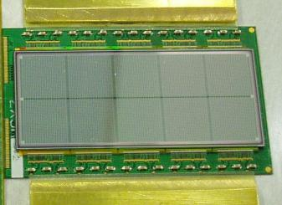
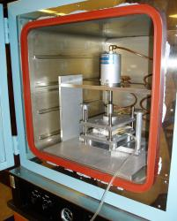
2006 Purdue Plaquette Assembly Line
Quality Assurance performed at every stage

Slide 26

2006 Daily Production Assembly Plan
Master schedule requires assembly of ~800 Plaquettes in Time Period = 140 work days
Rate of assembly required = 6 Plaquettes / day
Assembly steps, time and personnel requirements to process 6 Plaquettes / day
(starting with tested VHDI, BB modules and pre-cut film adhesive)
New project: reduced number of personnel
5 assembly stations work 1.25 hr/plaquette
7.5 hr/day + 0.5 hr/station for setup, inspection, documentation & cleanup.
A Quality Assurance/debug/rework station
works in parallel to assembly line.
9 personnel:
Arndt (Engineer), Bolla & Merkel (Eng. Physicists), Graves (Lab Tech), 5 temporary technicians

Slide 27


Assembly flowcharts: pick-and-place
LHC CMS
Detector
Upgrade
Project

Slide 28

Top-down exploded view

Slide 29

Bottom-up exploded view

Slide 30


HDI pick-up tool with suction cups lifting HDI + module end holders
HDI pick-up tool with suction cups

Slide 31

Assembly Flow
Baseplate with vacuum chucks for parts (mounted on 1” standoffs on gantry tabletop)

Slide 32

Assembly Flow (con’t)
Place BBM and HDI by hand on vacuum chucks

Slide 33

Assembly Flow (con’t)
Place bridge tool over HDI by hand, aligned using guide pins in baseplate

Slide 34

Assembly Flow (con’t)
Vacuum spreader brought down by gantry head, turn on vacuum to spreader tool, turn off vacuum to HDI chuck on baseplate

Slide 35

Assembly Flow (con’t)
Lift vacuum spreader, bridge tool and HDI with gantry

Slide 36

Assembly Flow (con’t)
Place tools with HDI on BBM with gantry, turn on vacuum to bridge tool feet on baseplate, turn off vacuum to spreader tool

Slide 37

Assembly Flow (con’t)
Lift vacuum spreader with gantry from bridge tool

Slide 38

Assembly Flow (con’t)
Remove bridge tool after epoxy cures

Slide 39


Encapsulation
3-axis motion-controlled robot and programmable dispenser for accuracy and repeatability of wirebond encapsulation
Alternatively, can use the programmable dispenser + gantry positioning system to dispense the liquid encapsulant
Trying conical dispensing nozzle (shown above) with 50 micron ID orifice (used 100 micron ID syringe needle in the past)

Slide 40

Wirebond encapsulation in the past

Slide 41
FPIX Plaquette Encapsulation
The encapsulant (Dow Corning Sylgard 186) is removable. Wirebonding can be done again in case of failures
The 2-part encapsulant is mixed, poured into a syringe and degassed in a vacuum or centrifuge
The syringe is connected to an air powered fluid dispenser and inserted into a holder on a 3-axis stage (motion along rows of bond feet is motor-controlled).
Shape of encapsulant beads is determined by the rate of volume dispensed and the rate of motion of the syringe
Mixed encapsulant should be used between ~0.5 and ~1.5 hours after mixing. Fixture cure at room temp. is ~8 hours, full cure in 48 hours.
Estimate ~3 hours to encapsulate 6 plaquettes (including mixing and clean-up time).
See section 3.3 “Wirebonding and encapsulation” in Assembly and qualification procedures of CMS forward pixel detector modules, Nucl. Instrum. Meth. A638, Issue 1, 11 May 2011, Pages 55–62, doi:10.1016/j.nima.2011.02.106

Slide 42


FPIX Encapsulation result
ROC and VHDI wire bond feet were potted in separate encapsulant beads for each ROC

Slide 43

Bead dimensions
height ~100 um
height ~150 um
width ROC bead ~600 um
width VHDI bead ~900 um

